Slide 1
World Development Indicator
Big Data Foundation Track for UPx

Slide 2
Project Done By
Name : Shubhro Banerjee

Slide 3
Project Introduction
Domain : Social Sector
Technology Used: PigLatin on Hadoop Cluster
Dataset: http://databank.worldbank.org/data/reports.aspx?Code=IND&id=556d8fa6&report_name=Popular_countries&populartype=country&ispopular=y
This dataset is World Bank’s compilation of internationally comparable statistics about global development and the quality of people’s lives. It contains data about Agriculture & Rural Development, Aid Effectiveness, Climate Change, Economy & Growth, Education, Energy & Mining, Environment, External Debt, Financial Sector, Gender, Health, Infrastructure, Labor & Social Protection, Poverty, Private Sector, Public Sector, Science & Technology, Social Development, Trade, Urban Development.

Slide 4
Dataset Description
Series Name 2006 [YR2006]
Series Code 2007 [YR2007]
Country Name 2008 [YR2008]
Country Code 2009 [YR2009]
2000 [YR2000] 2010 [YR2010]
2001 [YR2001] 2011 [YR2011]
2002 [YR2002] 2012 [YR2012]
2003 [YR2003] 2013 [YR2013]
2004 [YR2004] 2014 [YR2014]
2005 [YR2005] 2015 [YR2015]

Slide 5
Technical Architecture
I am trying to use PigLatin to handle the “data exploration ideas” mentioned in the case-study.
There are 2 scenarios to be addressed,
a) Average growth rate. Example, Top 10 Improved sanitation facilities, Improved water source.
Formula taken from the following link,
https://www.wikihow.com/Calculate-Growth-Rate
b) Average rate. Example, Top 10 Energy use, Top 10 CO2 emissions.
I have used PIG UDF to calculate Average growth rate and Average rate

Slide 6
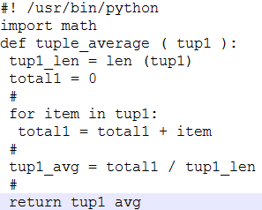
PIG UDFs
UDF to calculate Average.

Slide 7
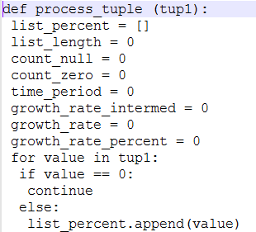
PIG UDF (contd..)
UDF to calculate Average Growth.

Slide 8
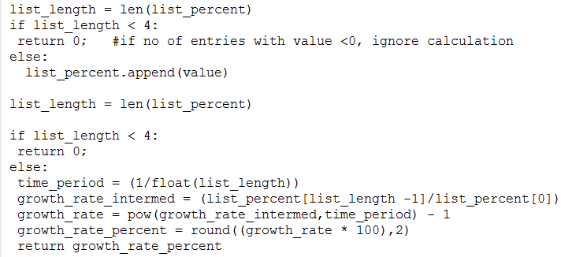
PIG UDF (contd..)

Slide 9
Business Questions Answered (contd.)
STEP-3: Load the Reviews dataset into table,
LOAD DATA INPATH 'sb_amazon_food_reviews/Reviews.csv'
OVERWRITE INTO TABLE amazon_food_review_table;
STEP-4: With CSV SerDe,all items will be implicitly type casted to STRING.
DESCRIBE amazon_food_review_table;
id string
productid string
userid string
profilename string
helpfulnessnumerator string
helpfulnessdenominator string
score string
time string
summary string
text string

Slide 10
Business Questions Answered (contd.)
STEP-5: Create another table within sb_amazon_food_review_db,
create EXTERNAL TABLE IF NOT EXISTS amazon_fine_food_table (Id INT, ProductId STRING, UserId STRING, HelpfulnessNumerator INT, HelpfulnessDenominator INT,Score INT, Time STRING)
ROW FORMAT DELIMITED
FIELDS TERMINATED BY ','
STORED AS TEXTFILE;
STEP-6: Copy all the content of table into amazon_food_review_table (created
in STEP-2) into amazon_fine_food_table (created in STEP-5)
INSERT OVERWRITE TABLE amazon_fine_food_table
SELECT CAST(Id as
INT),ProductId,UserId,CAST(HelpfulnessNumerator AS
INT),CAST(HelpfulnessDenominator AS INT),CAST(Score
AS INT),FROM_UNIXTIME(CAST(Time AS BIGINT)) FROM
amazon_food_review_table;

Slide 11
Business Questions Answered (contd.)
STEP-7: STEP-6 will cause typecasting as per the data set.
DESCRIBE amazon_fine_food_table;
id int
productid string
userid string
helpfulnessnumerator int
helpfulnessdenominator int
score int
time string
STEP-8 : Create a table to capture American Federal holidays.
CREATE TABLE IF NOT EXISTS american_holidays (holiday_name STRING, holiday_date STRING)
ROW FORMAT DELIMITED
FIELDS TERMINATED BY ':';
LOAD DATA INPATH
'sb_amazon_food_reviews/american_holiday_list.txt'
OVERWRITE INTO TABLE american_holidays;

Slide 12
Business Questions Answered (contd.)
Which are the top 10 Product IDs that get reviewed the most?
Query:
INSERT OVERWRITE DIRECTORY
'/apps/hive/warehouse/sb_amazon_food_review_db.db/CASE1'
SELECT ProductId,count(*) as review_count FROM
amazon_fine_food_table WHERE ProductId IS NOT NULL GROUP
BY ProductId ORDER BY review_count DESC LIMIT 10;

Slide 13
Business Questions Answered (contd.)
RESULT:
B007JFMH8M 913
B002QWP8H0 632
B0026RQTGE 632
B002QWP89S 632
B002QWHJOU 632
B003B3OOPA 623
B001EO5Q64 567
B007M83302 564
B0026KPDG8 564
B000VK8AVK 564

Slide 14
Business Questions Answered (contd.)
Which are the top 10 most favorably reviewed Product IDs?
Query :
INSERT OVERWRITE DIRECTORY '/apps/hive/warehouse/sb_amazon_food_review_db.db/CASE2'
SELECT ProductId,count(*) as score_count FROM amazon_fine_food_table
WHERE ProductId IS NOT NULL
AND Score = 5
GROUP BY ProductId
ORDER BY score_count DESC
LIMIT 10;

Slide 15
Business Questions Answered (contd.)
RESULT:
B007JFMH8M 624
B003B3OOPA 517
B000NMJWZO 502
B002QWHJOU 498
B0026RQTGE 498
B002QWP89S 498
B002QWP8H0 498
B001EO5Q64 474
B000VK8AVK 369
B001RVFEP2 369

Slide 16
Business Questions Answered (contd.)
How may product reviews are generated on a daily, monthly and yearly basis?
Query to generate count of daily reviews:
CREATE TABLE IF NOT EXISTS daily_reviews_data (completeTime STRING, num_of_reviews INT)
ROW FORMAT DELIMITED FIELDS TERMINATED BY ',';
INSERT OVERWRITE TABLE daily_reviews_data
SELECT Time, count(*) as daily_rep FROM
amazon_fine_food_table WHERE Time IS NOT NULL
GROUP BY Time;
INSERT OVERWRITE DIRECTORY
'/apps/hive/warehouse/sb_amazon_food_review_db.db/CASE3/Y
EARLY' SELECT ROUND(AVG(num_of_reviews)) FROM
yearly_reviews_data;
RESULT: 179.0

Slide 17
Business Questions Answered (contd.)
Query to generate count of monthly reviews:
CREATE TABLE IF NOT EXISTS monthly_reviews_data (monthTime STRING, num_of_reviews INT) ROW FORMAT
DELIMITED FIELDS TERMINATED BY ',';
INSERT OVERWRITE TABLE monthly_reviews_data
SELECT date_format(Time,'yyyyMM'), COUNT(*) FROM
amazon_fine_food_table
WHERE Time IS NOT NULL
GROUP BY date_format(Time,'yyyyMM');
INSERT OVERWRITE DIRECTORY
'/apps/hive/warehouse/sb_amazon_food_review_db.db/CASE3/M
ONTHLY' SELECT ROUND(AVG(num_of_reviews)) FROM
monthly_reviews_data;
RESULT: 3975.0

Slide 18
Business Questions Answered (contd.)
Query to generate count of yearly reviews:
CREATE TABLE IF NOT EXISTS yearly_reviews_data
(yearTime STRING, num_of_reviews INT) ROW FORMAT
DELIMITED FIELDS TERMINATED BY ',';
INSERT OVERWRITE TABLE yearly_reviews_data
SELECT YEAR(Time), count(*) as daily_rep FROM
amazon_fine_food_table WHERE Time IS NOT NULL
GROUP BY YEAR(Time);
INSERT OVERWRITE DIRECTORY
'/apps/hive/warehouse/sb_amazon_food_review_db.db/CASE3/
YEARLY' SELECT ROUND(AVG(num_of_reviews)) FROM
yearly_reviews_data;
RESULT: 40604.0

Slide 19
Business Questions Answered (contd.)
Product sales- festival mapping. By festival mapping we are trying to analyze the top 3 Product IDs that get reviewed the most for each of the major festivals in the USA?
CREATE TABLE IF NOT EXISTS festival_reviews (ProductId STRING,date_yr STRING) ROW FORMAT DELIMITED FIELDS TERMINATED BY ',' LINES TERMINATED BY '\n';
INSERT OVERWRITE TABLE festival_reviews
SELECT ProductId,Time FROM amazon_fine_food_table AFFT
JOIN american_holidays AH
ON (from_unixtime(unix_timestamp(AFFT.Time,'yyyy-MM-dd hh:mm:ss'),'MM-dd') = AH.holiday_date);

Slide 20
Business Questions Answered (contd.)
INSERT OVERWRITE DIRECTORY '/apps/hive/warehouse/sb_amazon_food_review_db.db/CASE4'
SELECT ProductId, count(*) as review_count FROM festival_reviews
WHERE ProductId IS NOT NULL
GROUP BY ProductId
ORDER BY review_count DESC
LIMIT 3;
RESULT:
B001OCKIP0 33
B001EQ55RW 18
B005HG9ERW 10

Slide 21
Errors Encountered
hive (sb_amazon_sample_data)> INSERT OVERWRITE TABLE amazon_sample_table1 > SELECT CAST(Id as INT),ProductId,UserId,CAST(HelpfulnessNumerator AS INT),CAST(HelpfulnessDenominator AS INT),CAST(Score AS INT),
FROM_UNIXTIME(Time) FROM amazon_sample_table;
FAILED: SemanticException [Error 10014]: Line 2:129 Wrong arguments 'Time':
No matching method for class org.apache.hadoop.hive.ql.udf.UDFFromUnixTime with (string).
Possible choices: _FUNC_(bigint) _FUNC_(bigint, string) _FUNC_(int) _FUNC_(int, string)
Reason: Incorrect arguments were passed to FROM_UNIXTIME function.
hive (sb_amazon_sample_data)> SELECT Time, count(*) as daily_rep FROM amazon_sample_table1 GROUP BY YEAR(Time);FAILED:
SemanticException [Error 10025]: Line 1:7 Expression not in GROUP BY key 'Time'
Reason: the group by should have all the fields selected in a Query.

Slide 22


